Slide 1
Developing a National Critical Care Clinical Research Network:
what’s in it for trainees?
Paul Dark
Associate Professor,
Faculty of Medical and Human Sciences,
University of Manchester
Academic Director, Acute Tissue Injury and Trauma,
Manchester Academic Health Science Centre
Honorary NHS Consultant,
Critical Care Medicine,
Salford Royal NHS Foundation Trust

Slide 2
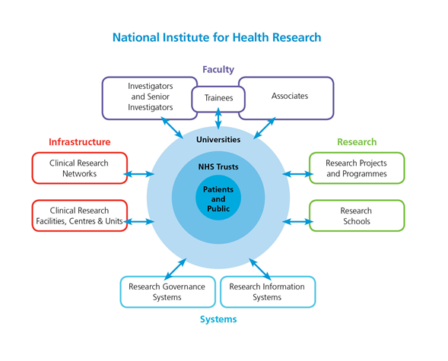

Slide 3
INVENTION
EVALUATION
ADOPTION
DIFFUSION
Basic Research
Development Pathway Funding
MRC
Efficacy & Mechanism Evaluation
Invention for Innovation
Biomedical Research Centres
Biomedical Research Units
This pathway covers the full range of interventions - pharmaceuticals, biologicals, biotechnologies, procedures, therapies and practices - for the full range of health and health care delivery - prevention, detection, diagnosis, prognosis, treatment, care.
Patient Safety and Quality Research Centres
Research for Innovation, Speculation & Creativity
Research for Patient Benefit
National Institute for Health Research
Health Services Research
Programme Grants for Applied Research
Public Health Research
Service Delivery & Organisation
Health Technology Assessment
Collabs for Ldrshp in Appl Hlth Res and Care
Ctr for Reviews & Dissemination, Cochrane, TARs
NHS Purchasing & Supplies Agency
Centre for Evidence-based Purchasing
National Institute for Health & Clinical Excellence
Guidance on Health & Healthcare
NHS Evidence
Access to Evidence
NHS Institute for Innovation & Improvement
Support for the NHS
Strategic Health Authorities
Duty of Innovation
Primary Care Trusts
Healthcare Commissioning
NHS Providers
Patient Care

Slide 4
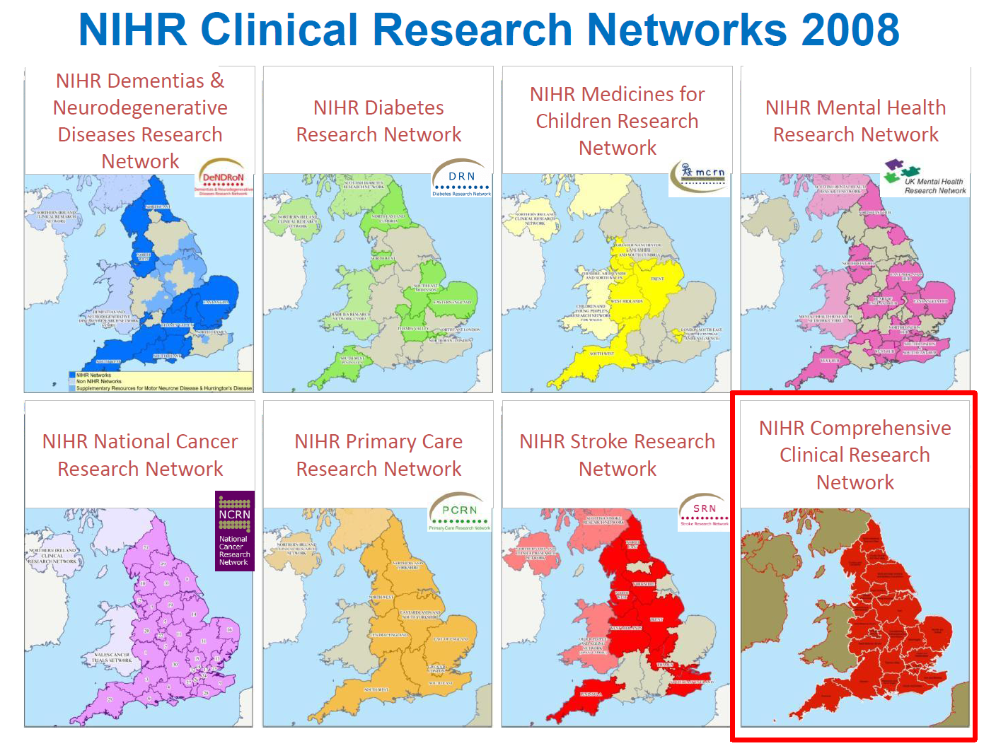

Slide 6
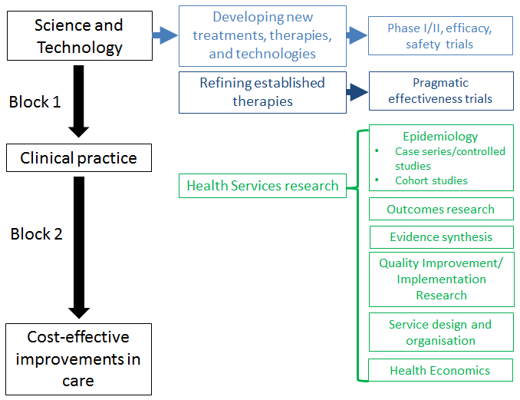
Developing a balanced NIHR-adopted portfolio

Slide 7
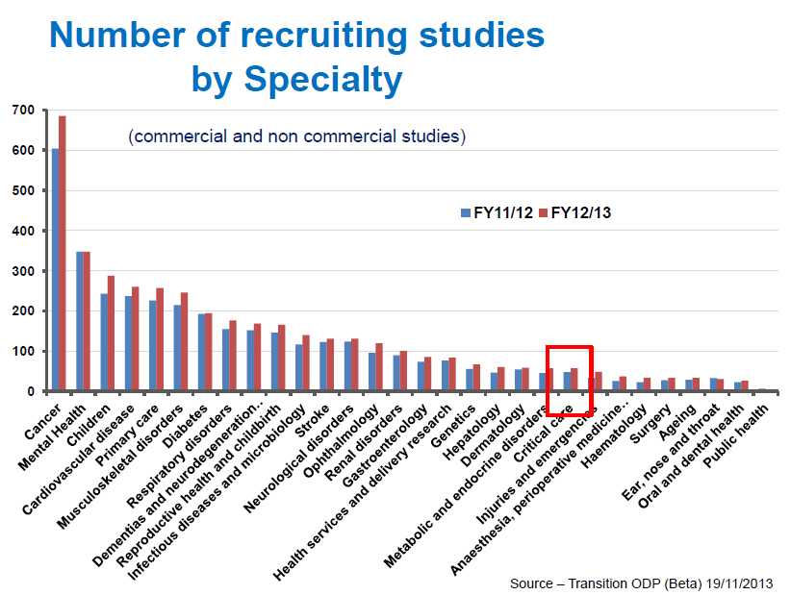

Slide 8
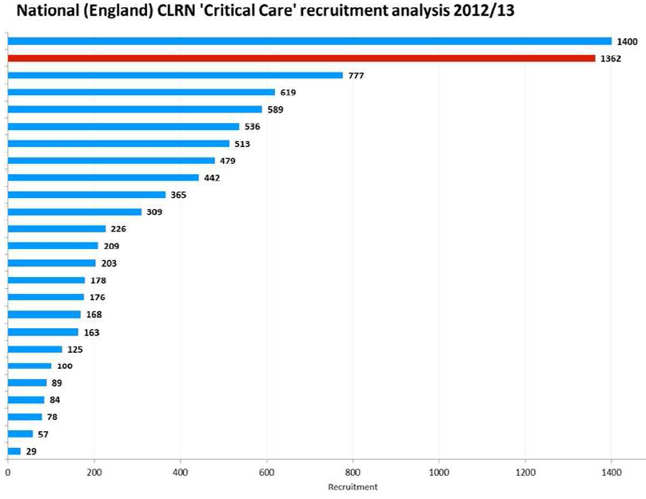

Slide 9
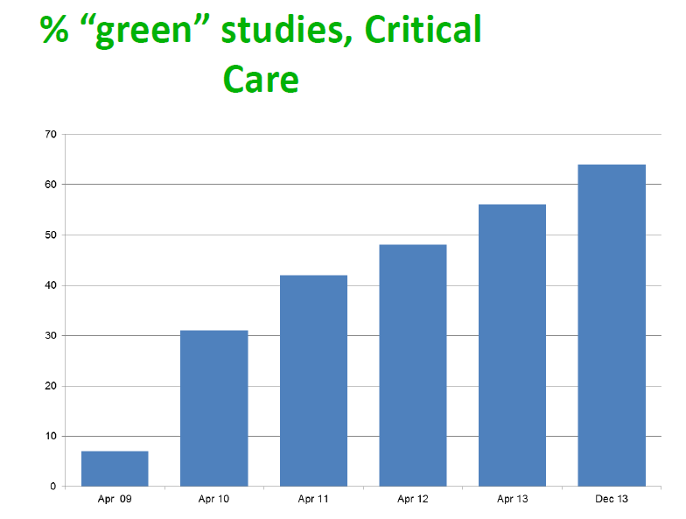

Slide 10
Key Specialty Group Achievements
Costing trials/studies
Maximising recruitment
–Site selection
–Co-enrolment
–Trial coordination
Patient Access to Research
External branding of UK Critical Care research for DoH
International Collaboration
UK Critical Care Research Forum
Research leadership for ‘Leadership Forum’

Slide 12
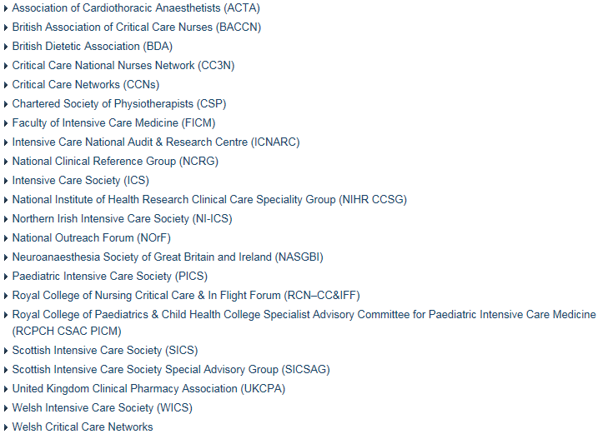

Slide 13
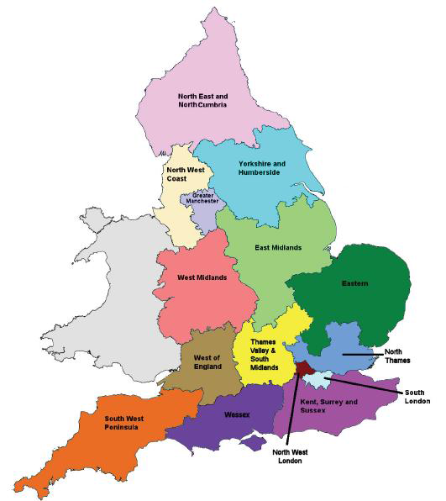
Reorganisation 2014 + further ‘refinement’ 2015

Slide 14
Acknowledged challenges for the future
Structure and Process
Maintaining communication
–Clinician time; expanding geographies
Developing research leaders and deliverers for the future
Recognising complexity
–Recruitment, delivering interventions, and measuring process/outcomes
Getting “right patient into right study at right time” (7 day working; 24/7 recruitment)
‘Improve quality for lower costs’
Outcomes
Smarter trial design methodologies
More efficient research design
Understanding cost-effectiveness better for the critically ill population
Delivering for the entire “critical care patient pathway”

Slide 15
New leadership from June 2015
Stability and continuity for Critical Care Research Network
Deliver Critical Care Research branding for DoH and specialty
Maintain specialty identity while improving resource efficiency
Grow international collaboration
Establish improved commercial portfolio
- Pharam
- Life Sciences and MedTech Industries
Trainee ‘involvement’ in research

Slide 16
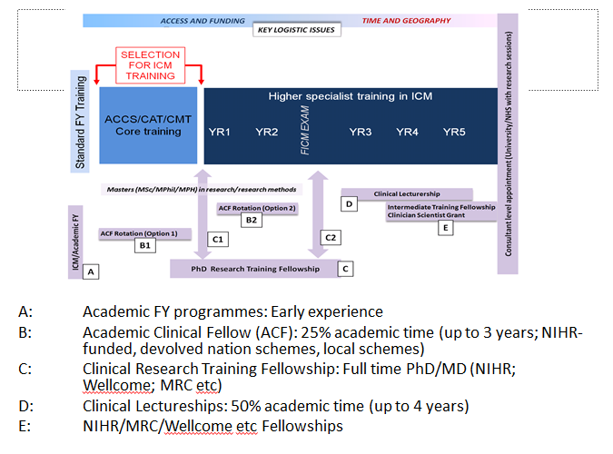
Improve opportunity and access for formal academic training in ICM

Slide 17
How could a research delivery network support access
to a research curriculum in specialist training?
?

Slide 18
Acknowledgments:
Professor Tim Walsh
Critical Care Medicine
University of Edinburgh
NIHR CRN National Specialty Lead, Critical Care (2008-15)

