Slide 1
How crowdsourcing informed the design of a new clinical trial: introducing ADAPT-Sepsis
Paul Dark
Professor of Critical Care Medicine,
University of Manchester
NIHR National Research Lead in Critical Care,
NIHR Visiting Professor,
King’s College London
Consultant in Critical Care Medicine,
Salford Royal NHS Foundation Trust

Slide 2
National research priority
New pragmatic trial
‘Crowdsourcing’ across NHS
Study design in evolution
Source: Shaylor on Flickr

Slide 3
Context of sepsis care in UK and recent involvement of NICE leading to research priority
Sepsis is a significant cause of death and disability in the UK
We want complaining to make a difference and so we are
publishing our first clinical report
It focuses on complaints we investigated about patients with
sepsis who did not receive the treatment they urgently needed
In every case, tragically the patient died
In some cases, with better care and treatment, they may have survived
Dame Julie Mellor Parliamentary and Health Service Ombudsman for England September 2013

Slide 4
Context of sepsis care in UK and recent involvement of NICE leading to research priority
Sepsis is a significant cause of death and disability in the UK
We want complaining to make a difference and so we are
publishing our first clinical report
It focuses on complaints we investigated about patients with
sepsis who did not receive the treatment they urgently needed
In every case, tragically the patient died
In some cases, with better care and treatment, they may have survived
Dame Julie Mellor Parliamentary and Health Service Ombudsman for England September 2013

Slide 5
Context of sepsis care in UK and recent involvement of NICE leading to research priority
Sepsis is a significant cause of death and disability in the UK
We want complaining to make a difference and so we are
publishing our first clinical report
It focuses on complaints we investigated about patients with
sepsis who did not receive the treatment they urgently needed
In every case, tragically the patient died
In some cases, with better care and treatment, they may have survived
Dame Julie Mellor Parliamentary and Health Service Ombudsman for England September 2013
a. NHS Clinical guidelines
b. Diagnostic guidance
on tests for rapid sepsis detection and monitoring

Slide 6
Background
NICE Diagnostic Guidance DG18 (Oct. 2015): Procalcitonin testing for diagnosing and monitoring sepsis
NICE commissioned an independent systematic review of clinical and cost effectiveness
8 RCTs focused on daily serum/plasma PCT algorithms in addition to standard care vs. standard care alone aimed at antibiotic discontinuation in sepsis
One small study comparing antibiotic discontinuation - PCT vs CRP
All studies independently judged ‘uncertain quality’ with some ‘at significant risk of bias’

Slide 7
Background
NICE Diagnostic Guidance DG18 (Oct. 2015):
All RCTs used:
PCT discontinuation algorithms with multiple decision thresholds to guide antibiotic treatment in intervention arms
Common decision thresholds (definitive <0.25µg/l; advisory <0.50µg/l) and often included relative decline (80% from baseline)
Final decision resting with treating clinician
Consistency of advice around discontinuation rules in intervention arms
Escalation protocol following ICU admission (= one study not meeting inclusion criteria caused harm)

Slide 8
Background
NICE Diagnostic Guidance DG18 (Oct. 2015):
Systematic review findings
PCT discontinuation algorithms associated with reductions in antibiotic duration when compared with standard care
Trend to reductions in length of stay (ICU and hospital)
Decreased resource utilisation
No evidence of harm (e.g. mortality, organ function and infection relapse/recurrence)
Note - improved mortality outcomes in recent SAPS study (Netherlands 2016)

Slide 9
Background
NICE Diagnostic Guidance DG18 (Oct. 2015):
Conclusions and recommendations for PCT-guided treatment
Lack of a systematic evidence from the UK
Uncertainty as to whether the results could be replicated in current standard NHS clinical practice (antibiotic duration and stewardship)
Serious concerns about performance bias in each study
Insufficient evidence to recommend routine adoption of PCT in the NHS and that further research is recommended
Is there a role for CRP monitoring?

Slide 10
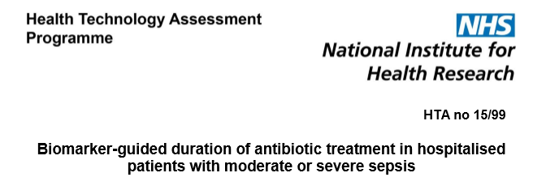
Background
Research Question:
Does a treatment protocol based on serial monitoring of C-reactive protein or procalcitonin safely allow reduction in duration of antibiotic therapy in hospitalised patients with sepsis?
Specifies: definitive 3-arm RCT

Slide 11
Background
Announced Spring 2015
Shortlist (n=2/5) for full application Autumn 2015
Final submission Jan. 2016
Decision March 2016 “subject to certain conditions”
Contracts in negotiation (circa £2 million)

Slide 12
Grantsmanship
How to win a commissioned research call from NIHR
Know and adhere to the call brief
Firm knowledge of relevant systematic reviews (or perform one) and new data
Form a collaborative team with all the skills and competencies
Neutralise competition (invite strategic collaboration)
Have a data-driven/evidence-based knowledge of the NHS care pathway
to develop and defend trial design

Slide 13
Preliminary questions
1. Antibiotic duration for sepsis in the UK?
No readily available high quality reliable data from UK
International recommendations: 7-10 days (Surviving Sepsis Guidelines)
PHE antibiotic stewardship guidance: 7 days
Best estimate from Evelien de Jong (SAPS trial 2016)
RCT of PCT-guided antimicrobial duration in sepsis (ICU)
n = 1546
Median duration of antibiotic treatment 7 days (IQR 4-11) standard care arm

Slide 14
Preliminary questions
2. Is there equipoise in UK for PCT and CRP monitoring in sepsis?
Source: crowdsourcing.org

Slide 15
Preliminary questions
2. Is there equipoise in UK for PCT and CRP monitoring in sepsis?
Survey of healthcare professionals
380 contributors over 4 weeks
CRP frequently used non-systematically and with no defined stop rules
PCT used very infrequently and with reported stop rules consistent with NICE DG 18
High desire to take part in a large-scale pragmatic RCT (76%)
50 NHS service laboratories surveyed separately produced concordant results
and important assay platform information for trial feasibility

Slide 16
Proposed Trial design
BiomArker-guided Duration of Antibiotic treatment in hospitalised PaTients with Sepsis
ADAPT-Sepsis Trial
Biomarkers: Serum Procalcitonin (PCT) & C-reactive protein (CRP)

Slide 17
Proposed Trial design
BiomArker-guided Duration of Antibiotic treatment
in hospitalised patients with sepSiS
BADASS Trial
Biomarkers: Serum Procalcitonin (PCT) & C-reactive protein (CRP)

Slide 18
Proposed Trial design
Multicentre 3-arm randomised controlled trial with internal pilot
Progression and success criteria (from pilot to main study) will be assessed on:
recruitment
protocol adherence
Random group allocation
computer-generated randomisation sequence with the minimisation method using random blocks
randomised in a ratio of 1:1:1 to PCT:CRP: usual care
Stratification by:
type of unit (surgical, medical and critical care)
severity of sepsis
infection source
surgery or not

Slide 19
Proposed Trial design
Inclusion criteria
Age at least 18 years
Hospital inpatient
Sepsis defined pragmatically: patients receiving empiric intravenous antibiotics for sepsis
Within 24 hours of receiving first intravenous antibiotic treatment for sepsis
Main exclusion criteria
Prolonged antimicrobial therapy mandated (e.g. for tuberculosis, osteomyelitis)
Severely immunocompromised (e.g. neutropenia, less than 500 neutrophils/microliter)

Slide 20
Proposed Trial design
PCT protocol Standard care + daily serum PCT measurement until antibiotic discontinuation | CRP protocol Standard care + daily serum CRP measurement until antibiotic discontinuation
PCT < 0.25µg/l | CRP < 25mg/l
PCT fall by >80% from baseline or PCT > 0.25 & < 0.50 µg/l | CRP fall by 50% from baseline
PCT does not meet above criteria | CRP does not meet above criteria

Slide 21
Proposed Trial design
PCT protocol Standard care + daily serum PCT measurement until antibiotic discontinuation | CRP protocol Standard care + daily serum CRP measurement until antibiotic discontinuation
PCT < 0.25µg/l | CRP < 25mg/l
PCT fall by >80% from baseline or PCT > 0.25 & < 0.50 µg/l | CRP fall by 50% from baseline
PCT does not meet above criteria | CRP does not meet above criteria
PCT protocol Standard care + daily serum PCT measurement until antibiotic discontinuation | CRP protocol Standard care + daily serum CRP measurement until antibiotic discontinuation | Advice for both PCT and CRP groups delivered daily to treating clinician
PCT < 0.25µg/l | CRP < 25mg/l | “Biomarker measurement indicates that you should stop antibiotics immediately”
PCT fall by >80% from baseline or PCT > 0.25 & < 0.50 µg/l | CRP fall by 50% from baseline | “Biomarker measurement indicates that you consider stopping antibiotics today if consistent with patient condition”
PCT does not meet above criteria | CRP does not meet above criteria | “Continue your usual care”

Slide 22
Proposed Trial design
PCT protocol Standard care + daily serum PCT measurement until antibiotic discontinuation | CRP protocol Standard care + daily serum CRP measurement until antibiotic discontinuation
PCT < 0.25µg/l | CRP < 25mg/l
PCT fall by >80% from baseline or PCT > 0.25 & < 0.50 µg/l | CRP fall by 50% from baseline
PCT does not meet above criteria | CRP does not meet above criteria
PCT protocol Standard care + daily serum PCT measurement until antibiotic discontinuation | CRP protocol Standard care + daily serum CRP measurement until antibiotic discontinuation | Advice for both PCT and CRP groups delivered daily to treating clinician
PCT < 0.25µg/l | CRP < 25mg/l | “Biomarker measurement indicates that you should stop antibiotics immediately”
PCT fall by >80% from baseline or PCT > 0.25 & < 0.50 µg/l | CRP fall by 50% from baseline | “Biomarker measurement indicates that you consider stopping antibiotics today if consistent with patient condition”
PCT does not meet above criteria | CRP does not meet above criteria | “Continue your usual care”
PCT protocol Standard care + daily serum PCT measurement until antibiotic discontinuation | CRP protocol Standard care + daily serum CRP measurement until antibiotic discontinuation | Advice for both PCT and CRP groups delivered daily to treating clinician | Standard care arm advice delivered daily to treating clinician
PCT < 0.25µg/l | CRP < 25mg/l | “Biomarker measurement indicates that you should stop antibiotics immediately” | “Continue your usual care”
PCT fall by >80% from baseline or PCT > 0.25 & < 0.50 µg/l | CRP fall by 50% from baseline | “Biomarker measurement indicates that you consider stopping antibiotics today if consistent with patient condition” | “Continue your usual care”
PCT does not meet above criteria | CRP does not meet above criteria | “Continue your usual care” | “Continue your usual care”

Slide 23
Proposed Trial design
Primary outcome measures:
Effectiveness
Total duration of antibiotic treatment to 28 days following randomisation (superiority) measured in days (24-hour time periods from randomisation)
Safety
28-day all-cause mortality (non-inferiority) following randomisation as primary safety outcome

Slide 24
Proposed Trial design
Secondary effectiveness and safety outcomes to 28 days:
Antibiotic dose (measured as Defined Daily Dose)
Unscheduled care escalation/re-admission
Infection relapse/recurrence requiring further antibiotic treatment
Super-infection defined as new infection at a different anatomical site
All-cause mortality rates at 60 days will be collected via the Health and Social Care Information Centre and the Intensive Care National Audit and Research Centre
Health care system benefit measures:
Assessment of in-trial cost effectiveness
Critical care unit length and level of stay
Hospital length of stay

Slide 25
Proposed Trial design
A total sample size of 2760 (912 patients per group)
To detect both:
- a mean of 1-day reduction in antibiotic duration
(using a mean antibiotic duration of 7 days, a pooled standard deviation of 6 days, 90% power, a significance level of 5%, with a 5% withdrawals rate)
- a non-inferiority safety margin of 5%
(using a 1-sided significance level of 2.5%, 90% power and 5% withdrawal rate) assuming 28-day mortality is 15%.

Slide 26
Proposed Trial design
4.1 patients per month per centre

Slide 27
Proposed Trial design
Sub-group analyses
Community-acquired pneumonia
Hospital-acquired pneumonia
Urinary tract infection
Intra-abdominal infection
Infection with positive blood culture

Slide 28
Trial investigator team
Team ADAPT-Sepsis
Paul Dark (Salford Royal and University of Manchester) Chief Investigator
Gavin Perkins, Ranjit Lall and Simon Gates (Warwick Clinical Trials Unit)
Matt Stephenson (Health Economics – University of Sheffield)
Keith Young (PPIE – Intensive Care Society/ICUsteps/Salford Citizen Scientists)
Danny McAuley (Belfast)
Ronan McMullan (Belfast – Microbiology)
Tony Gordon (Imperial)
Mervyn Singer (UCL)
Peter Wilson (UCL - Microbiology)
Tim Walsh (Edinburgh)
Naz Lone (Edinburgh)
Jonathan Clayton (Clinical Biochemistry – Salford)
Gordon Carlson (Surgical sepsis – Salford)
Tim Russell (ICNARC)
Tim Felton (critical care pharmacology) and Kay Marshall (Pharmacy) – Manchester

Slide 29
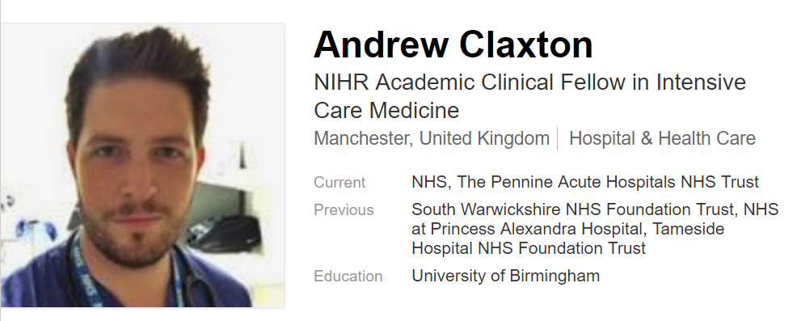
New recruits

Slide 30
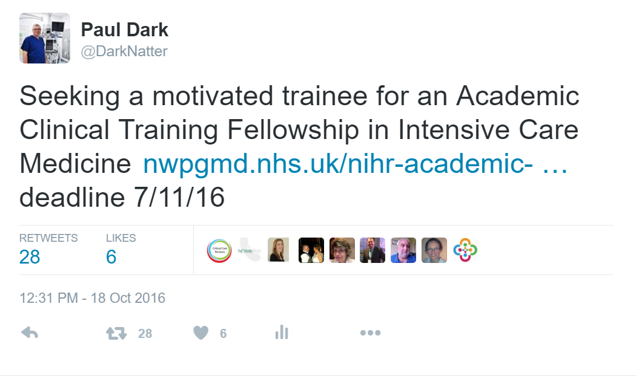
New trainee opportunity
www.nwpgmd.nhs.uk/nihr-academic-clinical-fellowships-glance

Slide 31
National research priority
New pragmatic trial
‘Crowdsourcing’ across NHS
Study design in evolution
Source: Shaylor on Flickr

